Slide 1

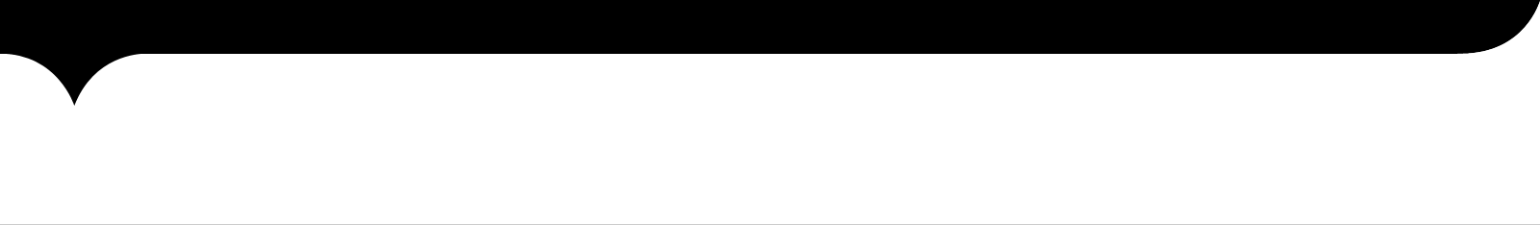

MINI-PROJECT PRESENTATION ON
AIRLINE RESERVATION SYSTEM
BY
GROUP 1 Dated: 27/02/2018
IGATE is now a part of Capgemini

Slide 2

TEAM MEMBERS
Apurv Agrawal (Team Lead)
Abhijit Panda
Lakshmi Bhavani
Bijal Majethia
Anbarasi
Ankur Kumar Gupta
Alauddin Abbas
Dhanalakshmi

Slide 3
OUTLINE
Introduction
Overview of Project
Admin
Executive
User
Test Cases
RVFD
Use Case
Defect Report
Test Summary
Metrics Calculation
Q & A

Slide 4
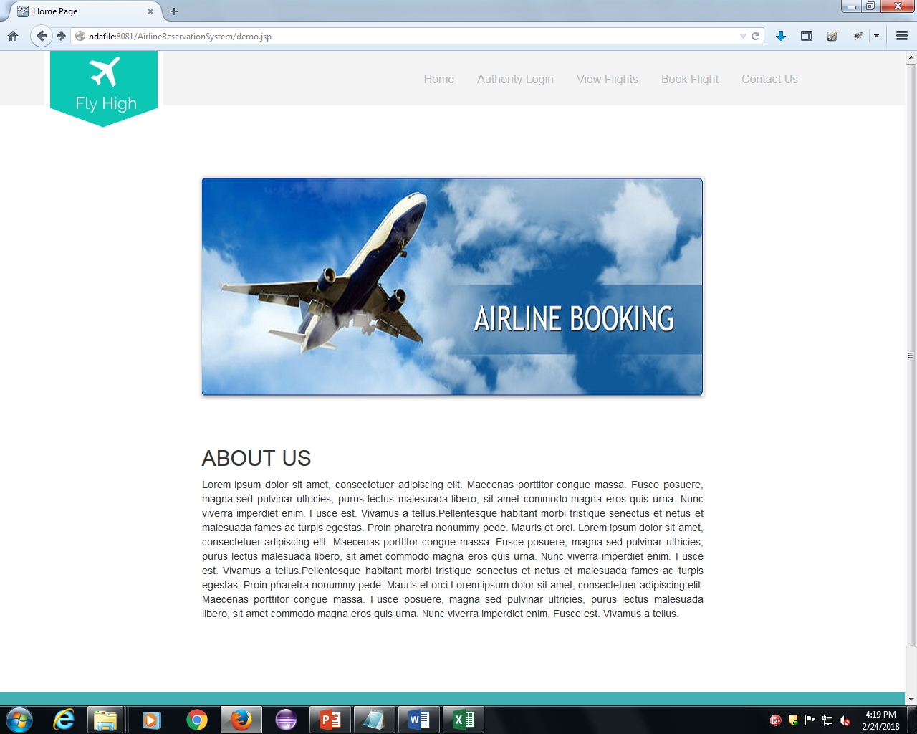
INTRODUCTION
WEBSITE LINK
http://ndafile:8081/AirlineReservationSystem/

Slide 5
INTRODUCTION Cont..
Various function available on the website:-
Authority Login
View Flights
Book Flights
Contact Us

Slide 6
OVERVIEW OF THE PROJECT CONT..
From the Requirement Sheet and Website given:-
Test Cases
RVFD
Defect Report
Use Cases

Slide 7
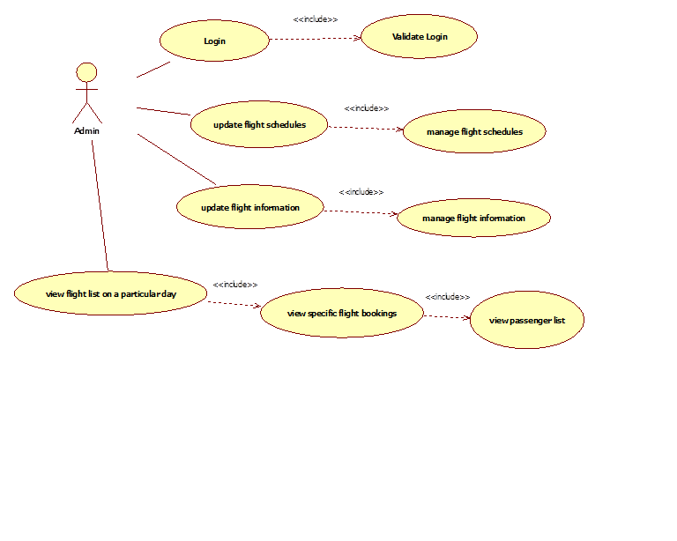
The administrator has the right to keep track of the flight details:
ADMIN
Login
Update
Manage
Report

Slide 8
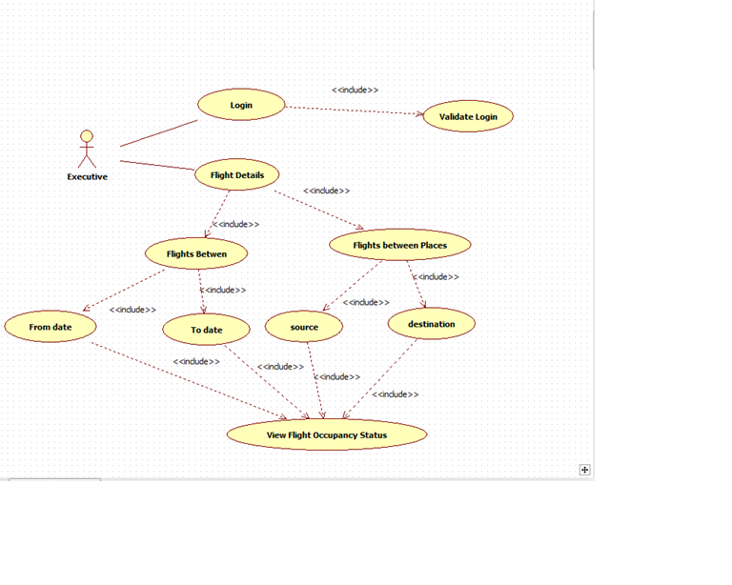
Airline-executive alone will be able to view flight-occupancy
EXECUTIVE
Login
View Details

Slide 9
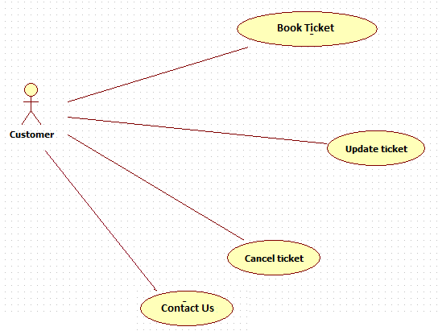
USER
User can reserve a flight ticket and also update or cancel his reservation
Reserve or Book
Update
Cancel
Contact Us

Slide 10
TEST CASES
Admin
Login
Executive
View Flights
User
Login
Book Flights
View Flights Acc. To Period
View Flights Acc. To Place
Contact

Slide 11
REQUIREMENT ITEMIZATION
Requirement Itemization or RVFD is a technique to separate the requirements into different categories.
This is basically used to simplify the requirements and detect the undetected defects.
The categories of requirements are:

Slide 12
RVFD Cont..
Security
It Involves Login, Logout and Payment
Explicit
It involves the method by which application can be invoked
Invocation
Implicit
It involves all function mention in Requirement sheet
It involves some common function implemented by Developer itself

Slide 13
RVFD Cont..
Termination
It involves the method by which application can be invoked
File Handling
It involve the things that need to be confirmed
System
Error Handling
Query
It involves the system requirements
It involves the storing of files in data base
It involves the possible error

Slide 14
USE CASE
View and Book Flights
Update Flights
Cancel Flights
Executive Login
View Flights based on Period
View Flights based on Place
Admin Login
Update Flight Schedules and Flight info
Generate Various Reports

Slide 15
DEFECT REPORT
What is Defect ?
Error or a bug, in the application which is created.
Flaws in the software are called defects
What is Defect Report ?
The report written for logging these defects

Slide 16
DEFECT REPORT Cont..
Components of a defect report
Defect ID
Defect description
Product version
Date raised
Reported by
Status
Fixed by
Date closed
Severity
Priority

Slide 17
DEFECTS FOUND Cont..
Executive and Admin Login
User Name is accepting Lower Boundary value
Contact Us
Email Field is Accepting Invalid Email
Name field is accepting Lower Boundary value
Book Flight
Date field should be in dd/mm/yyyy
Date field is accepting invalid Date
Password field not displaying proper Error msg.

Slide 18
DEFECTS FOUND Cont..
Flight Between Page
Heading is inappropriate
Date field is accepting invalid date
Fly High Logo
The Fly High Logo is not displaying proper page.
Payment Page
On clicking make payment with valid credentials, no booking confirmed message displayed

Slide 19
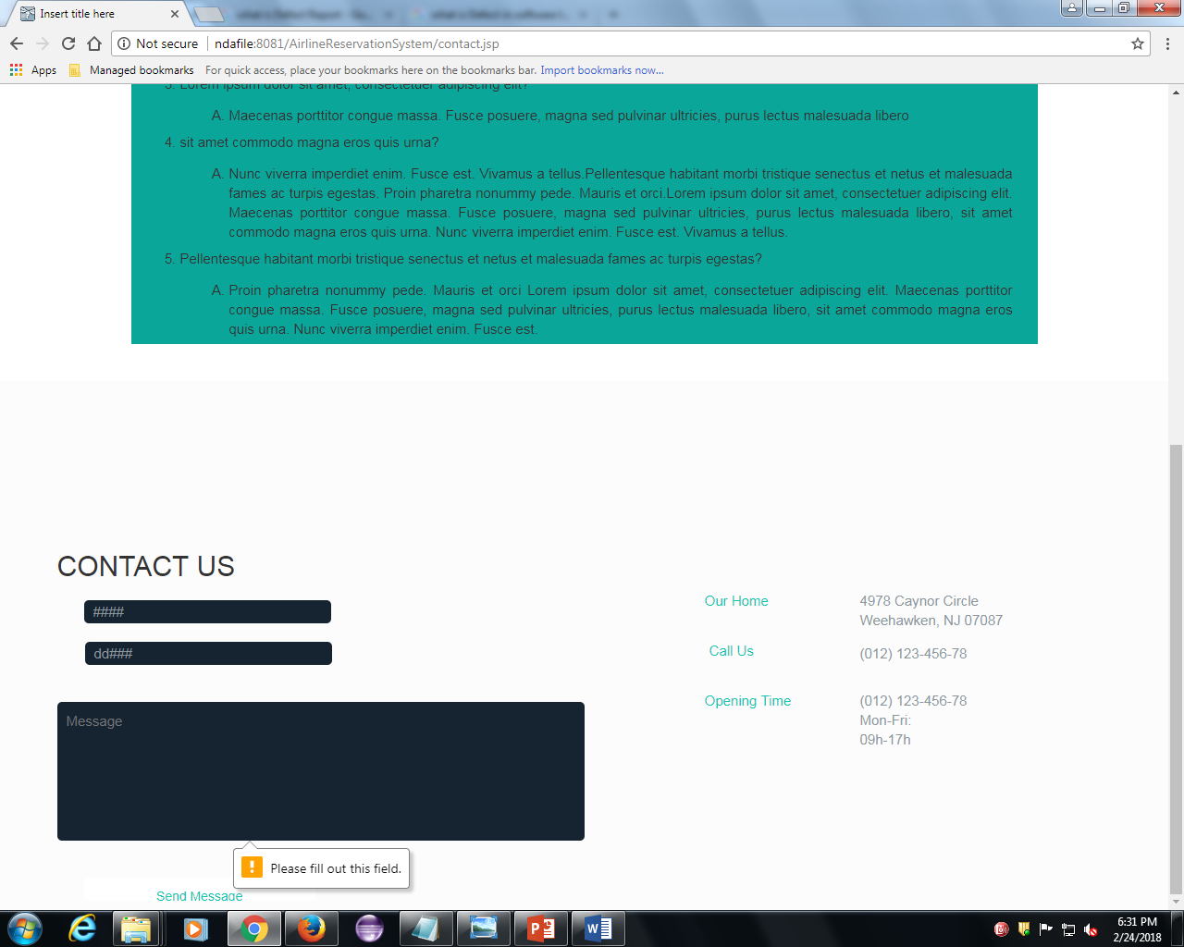
DEFECTS FOUND Cont..

Slide 20
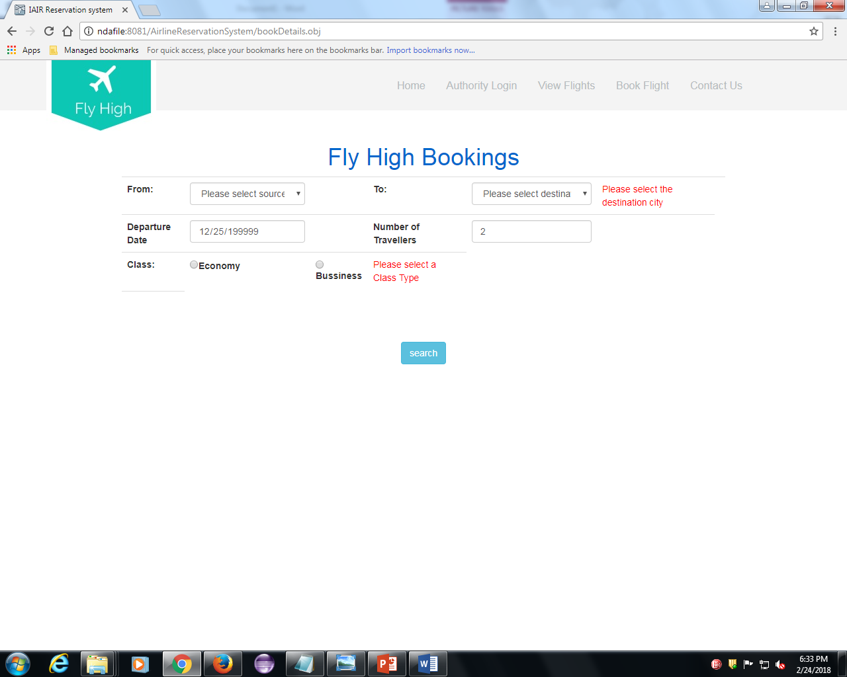
DEFECTS FOUND Cont..

Slide 21
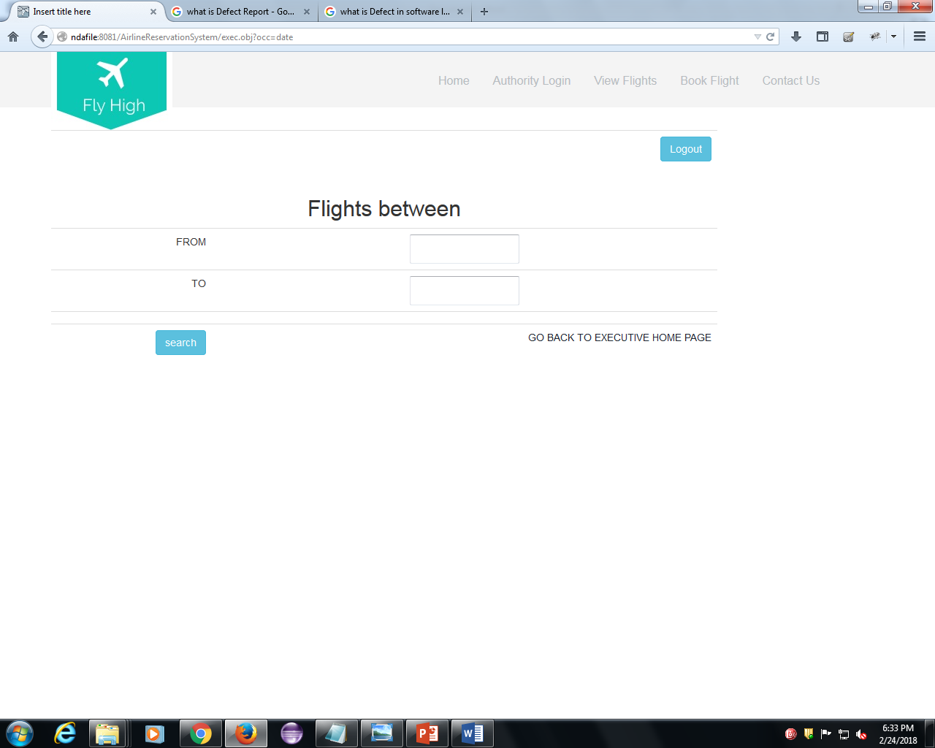
DEFECTS FOUND Cont..

Slide 22
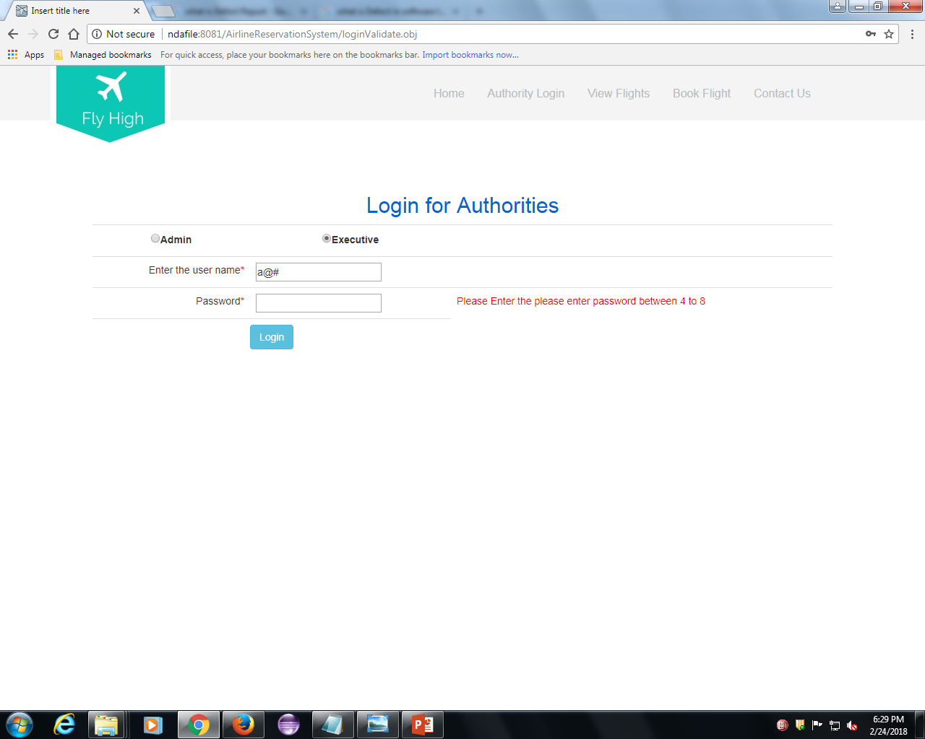
DEFECTS FOUND Cont..

Slide 23
TEST SUMMARY
We have tested the functionalities;-
Admin
Login
Executive
Login
View Flights Acc. To Period
View Flights Acc. To Place
User
View Flights
Book Flights
Contact

Slide 24
TEST SUMMARY Cont..
Test Cases
Total No. of Test cases = 77
Defects
Total No. of defects found =20
Use Cases
Total no. of flows = 9
Total No. of test cases passed = 57
Total No. of Test cases failed =20
People Worked
No. of People worked in this project = 8

Slide 25
METRICS CALCULATION
Test Case Effectiveness :
Test Case Effectiveness = No of defects detected using test cases*100/total no of test cases
=(20*100)/77
=25.4%

Slide 26
METRICS CALCULATION CONT..
Test Case Adequacy :
Test Case Adequacy = No. of actual Test cases*100/No of test cases estimated
=(77*100)/85
=90.58%

Slide 27

Thank You ! Q & A

